Slide 1
Library Management System using Data Structures
Venkata Pavani
25P61A05AB

Slide 2
Project Aim 🎯:
“To implement and demonstrate the use of Linked List, Stack, and Queue in managing books and student requests within a Library Management System using C programming.”

Slide 3
📌 Problem Statement:
Libraries need efficient systems to manage books.
Students borrow, return, and request books daily.
Manual handling is slow and can cause errors.
Data structures provide organised, efficient solutions.

Slide 4
🧩 Data Structures in the Project:
Data structures used in this project are linked lists, stacks and queues.
Linked list:A linked list is a linear data structure where elements, called nodes, are stored in separate memory locations and connected using pointers. Each node typically contains data and a reference to the next node.
Stacks: A stack is a linear data structure that follows the Last In, First Out (LIFO) principle, meaning the last element added is the first one to be removed.
Queues: A queue is a linear data structure that follows the First In First Out (FIFO) principle. This means that the first element added to the queue will be the first one to be removed.

Slide 5
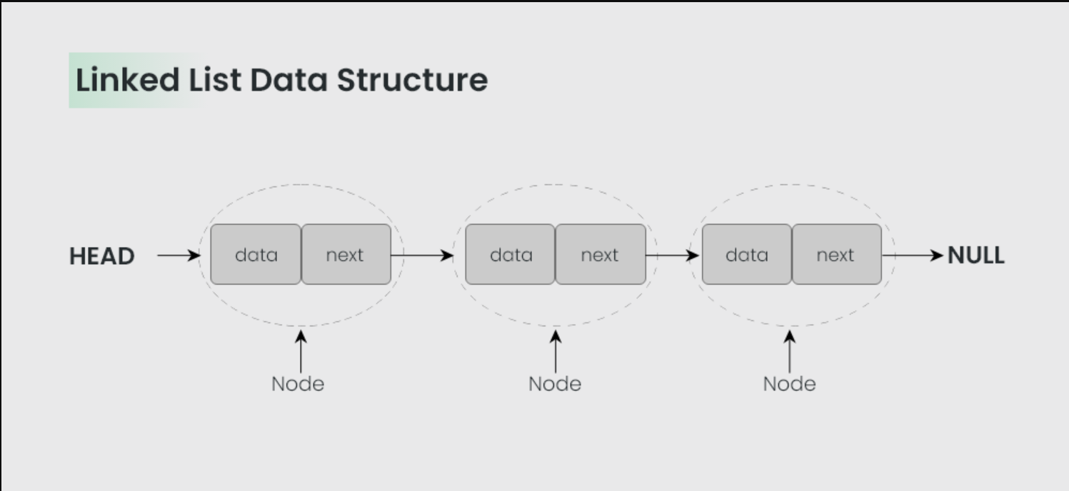

Slide 6
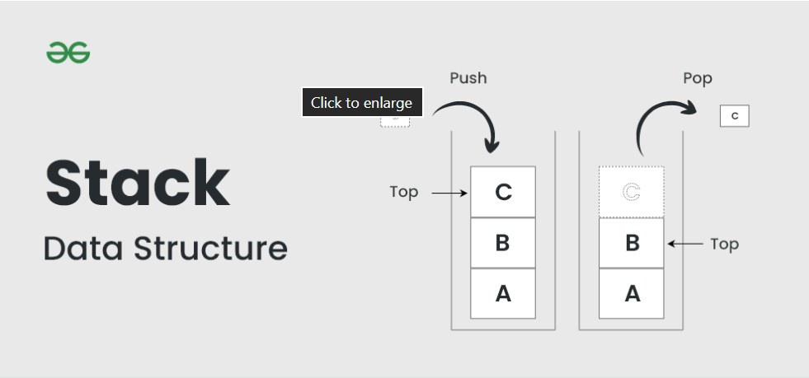

Slide 7
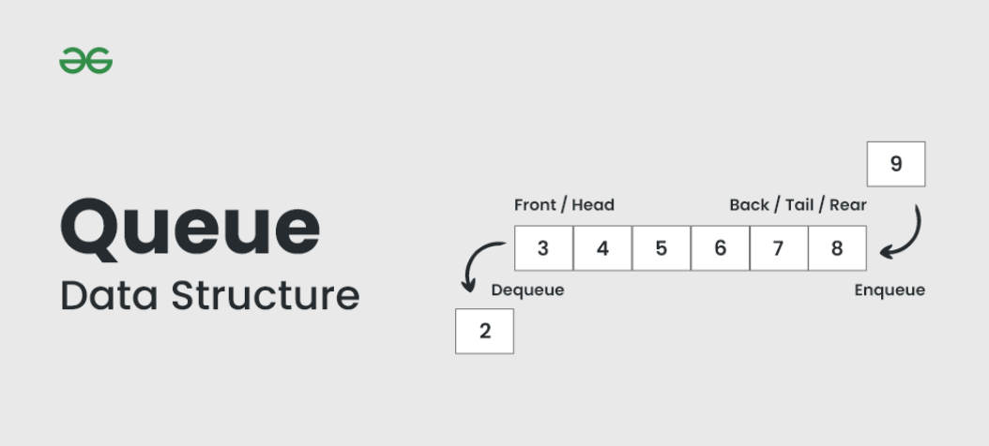

Slide 8
Purpose of using these data structures:
LINKED LIST: Store book records dynamically
STACK: Track borrowed books (LIFO)
QUEUE: Manage student requests (FIFO)

Slide 9
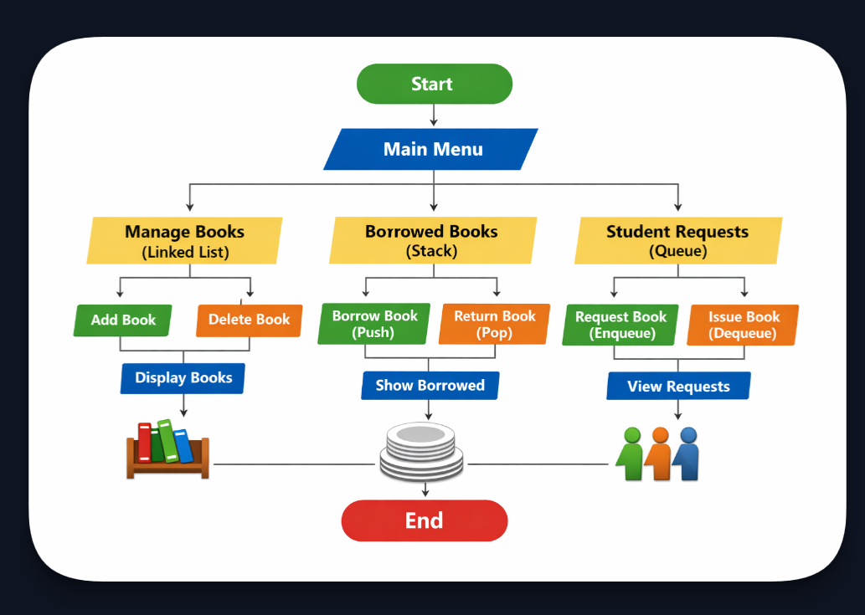
🔄 Library Management System Workflow

Slide 10
ALGORITHM :
Start → Main Menu
Manage Books (Linked List) → Add, Delete, Display
Borrowed Books (Stack) → Borrow (Push), Return (Pop), Show Borrowed
Student Requests (Queue) → Request (Enqueue), Issue (Dequeue), View Requests
End

Slide 11
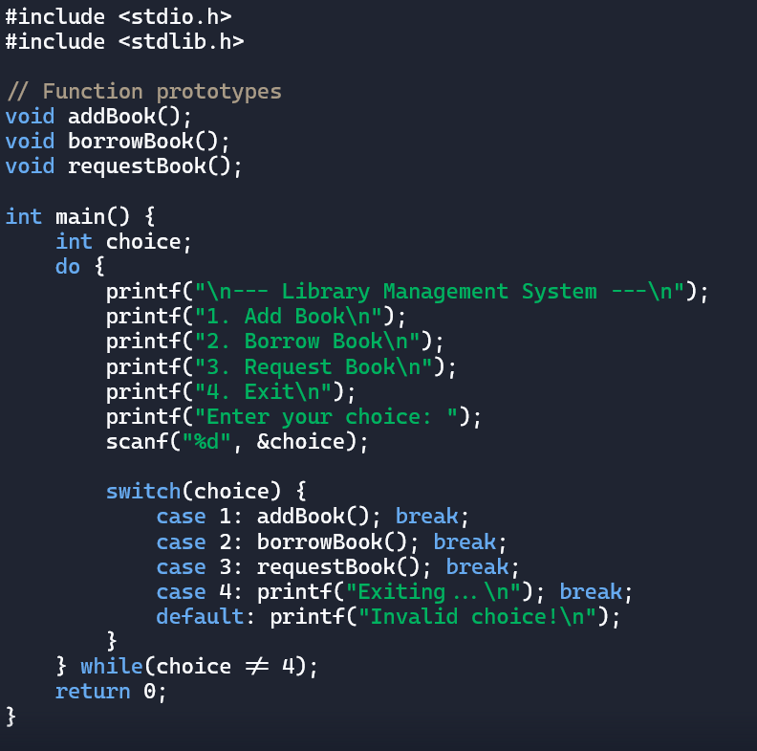
Program Highlights💻:
Written in C language using a menu-driven approach
Uses a linked list for dynamic book storage
Uses Stack to track borrowed books (LIFO principle)
Uses a queue to manage student requests (FIFO principle)
Functions like addBook(), borrowBook (), requestBook() handle each operation .

Slide 12
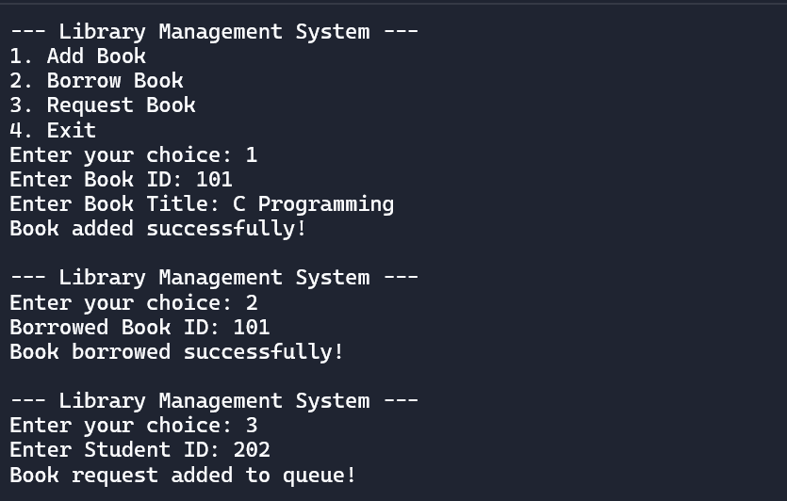
Sample output📊:

Slide 13
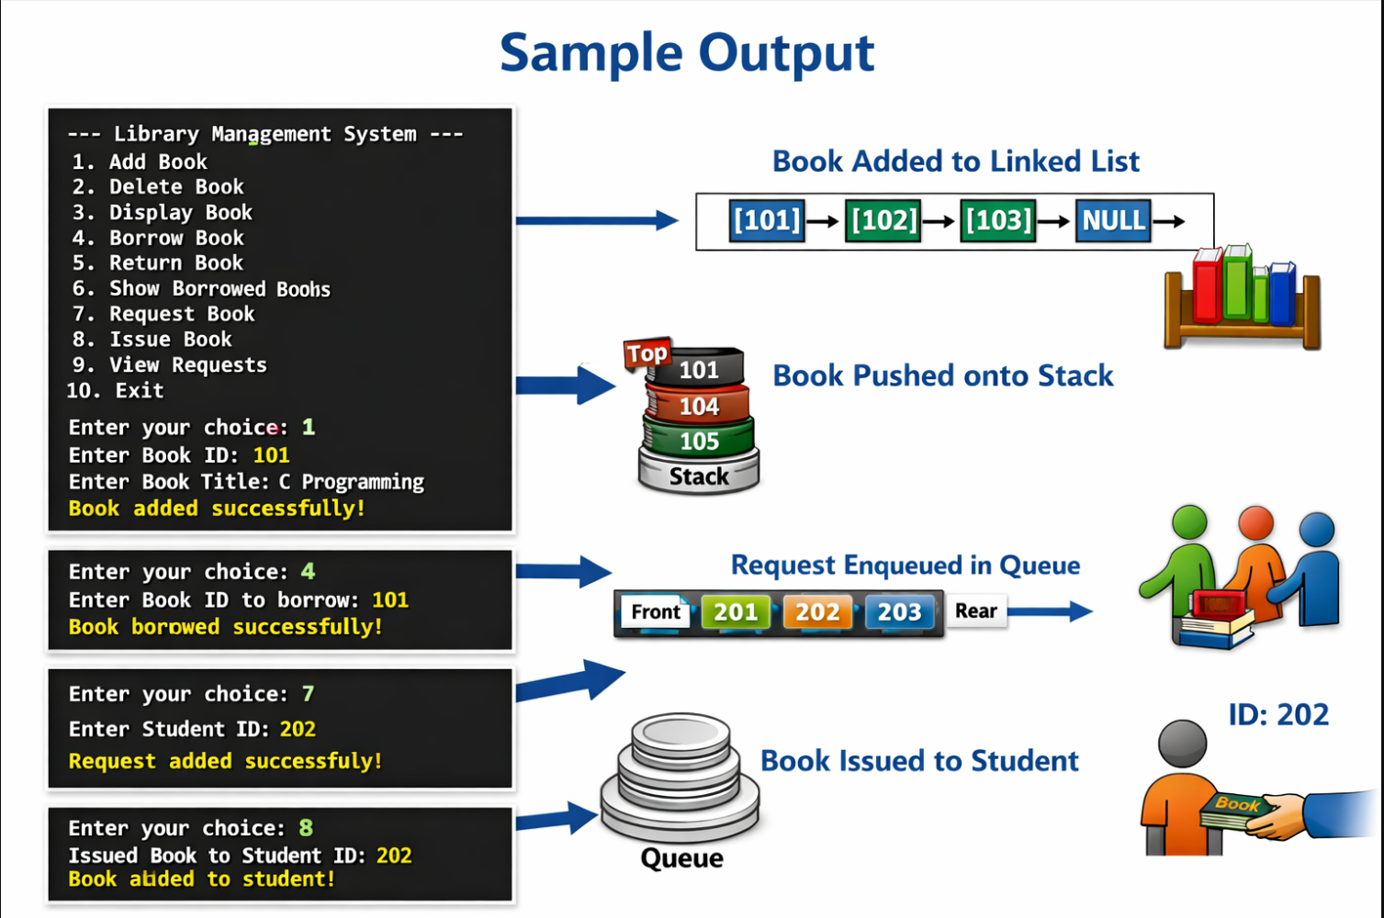

Slide 14
✅ Result
Successfully integrated Linked List, Stack, and Queue into one system.
Demonstrated dynamic book storage, borrowing, and student requests.
Program runs smoothly with menu-driven operations and sample test cases.

